Slide 1
Diabetes Type Prediction
Krishna Patel 19BCP071
Kunj Joshi 19BCP072
Dhrumin Patel 19BCP029
GROUP ID: 10
DATA MINING: 20CP306P

Slide 2
Diabetes is a disease which has been increasing ever since its discovery. Hence early prediction of Diabetes at an early stage is a need right now.
The change in lifestyles of young adults (age20-25) has also increased in Diabetes amongst this age group.
We have used a very detailed Dataset about diabetes and various factors that help in predicting diabetes. We have used detailed preprocessing to clean the data and given it as input to the different data mining models

Slide 3
This is the link to our dataset:
Diabetestype.csv - Google Drive
There are 1010 rows and 8 columns in our original dataset before cleaning. The dataset has been cleaned as per need. After cleaning, the dataset now has 7 columns and 1010 rows.

Slide 4
Factors used in predicting Diabetes:
Age
Blood Sugar Fasting
Blood Sugar (post prandial)
HbA1c
Random Plasma Sugar
Fasting Plasma Sugar

Slide 5
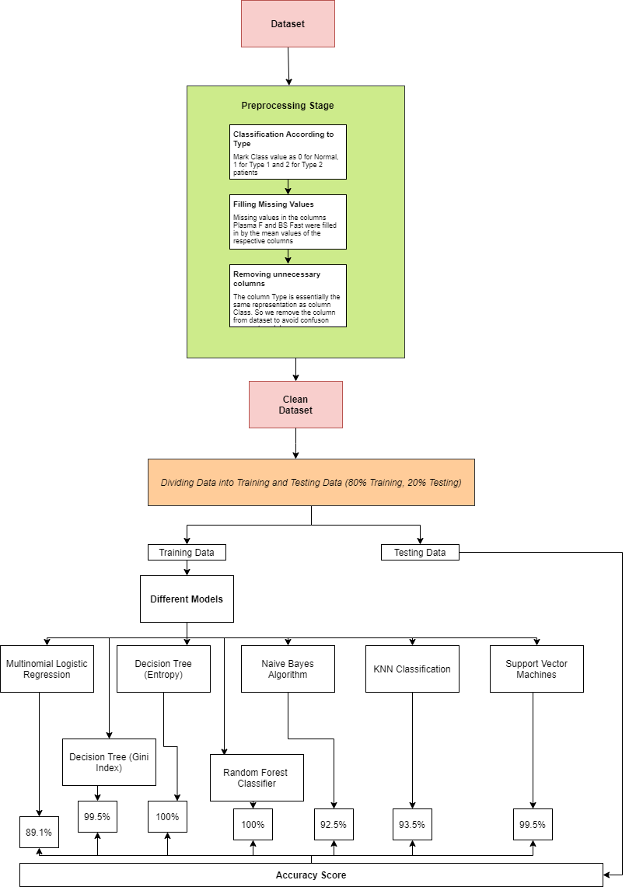
Architecture

Slide 6
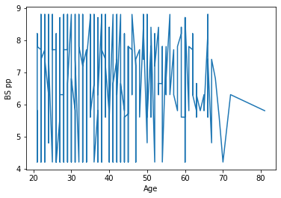
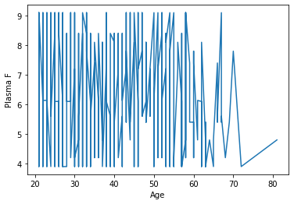
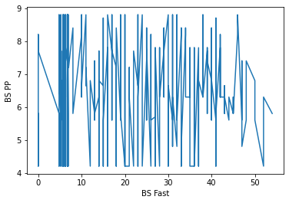
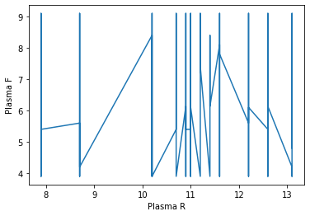
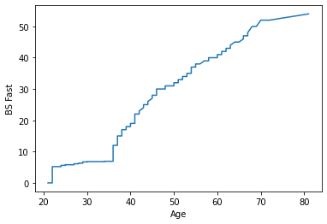
Data Visualistaion

Slide 7
Various models that has been used are as follow:
Multinomial Logistic Regression(82%-89%)
Decision Tree using Gini Index(97%-100%)
Decision Tree using Entropy(98%-100%)
Random Forest(99.5%-100%)
Naïve Bayes (89%-92%)
K Nearest Neighbor(89%-94%)
Support Vector Machine (99.5%-100%)
Diabetes prediction has been best proven using Support Vector Machine in Linear Kernel.

Slide 8
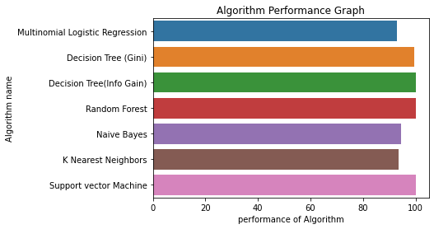
Algorithm Performance Graph

Slide 9
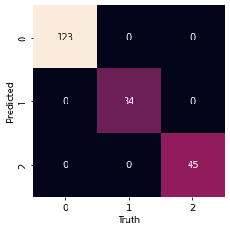
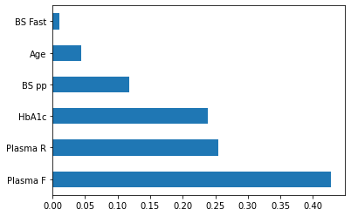
SVM Heatmap

Slide 10
Societal Impact
Young adults in the age of 20-25 have been predicted to be found to have consisted of 12.5% of the total diabetic population.
This is a dangerous trend that has grown due to lifestyle of the young adults. Such as people having addictions, eating a lot of fast food etc. leads to a diabetic lifestyle in the future stage.
This prediction machine can help government analyse diabetic population in a particular area and carry out the needed awareness camps or preventive measures.

Slide 11
The main aim of carrying out this analysis was to study the dataset and find out the best model that can predict diabetes perfectly.
Based on the data available our model will predict the accuracy i.e. if a person can have diabetes in future or is suffering from diabetes at a patient-level using the algorithms.
SVM has been proven as the most accurate model in predicting Diabetes with a consistency of 99.5-100%.

